Slide 1
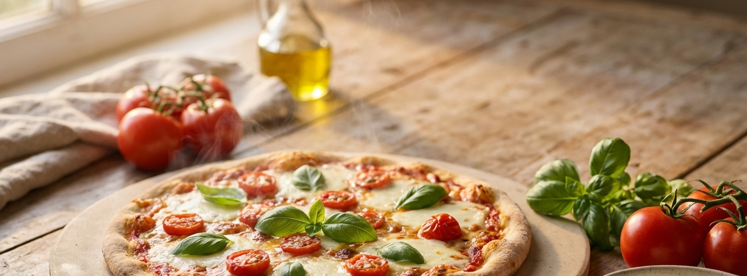
Pizza Sales Performance
Year overview and key insights

Slide 2
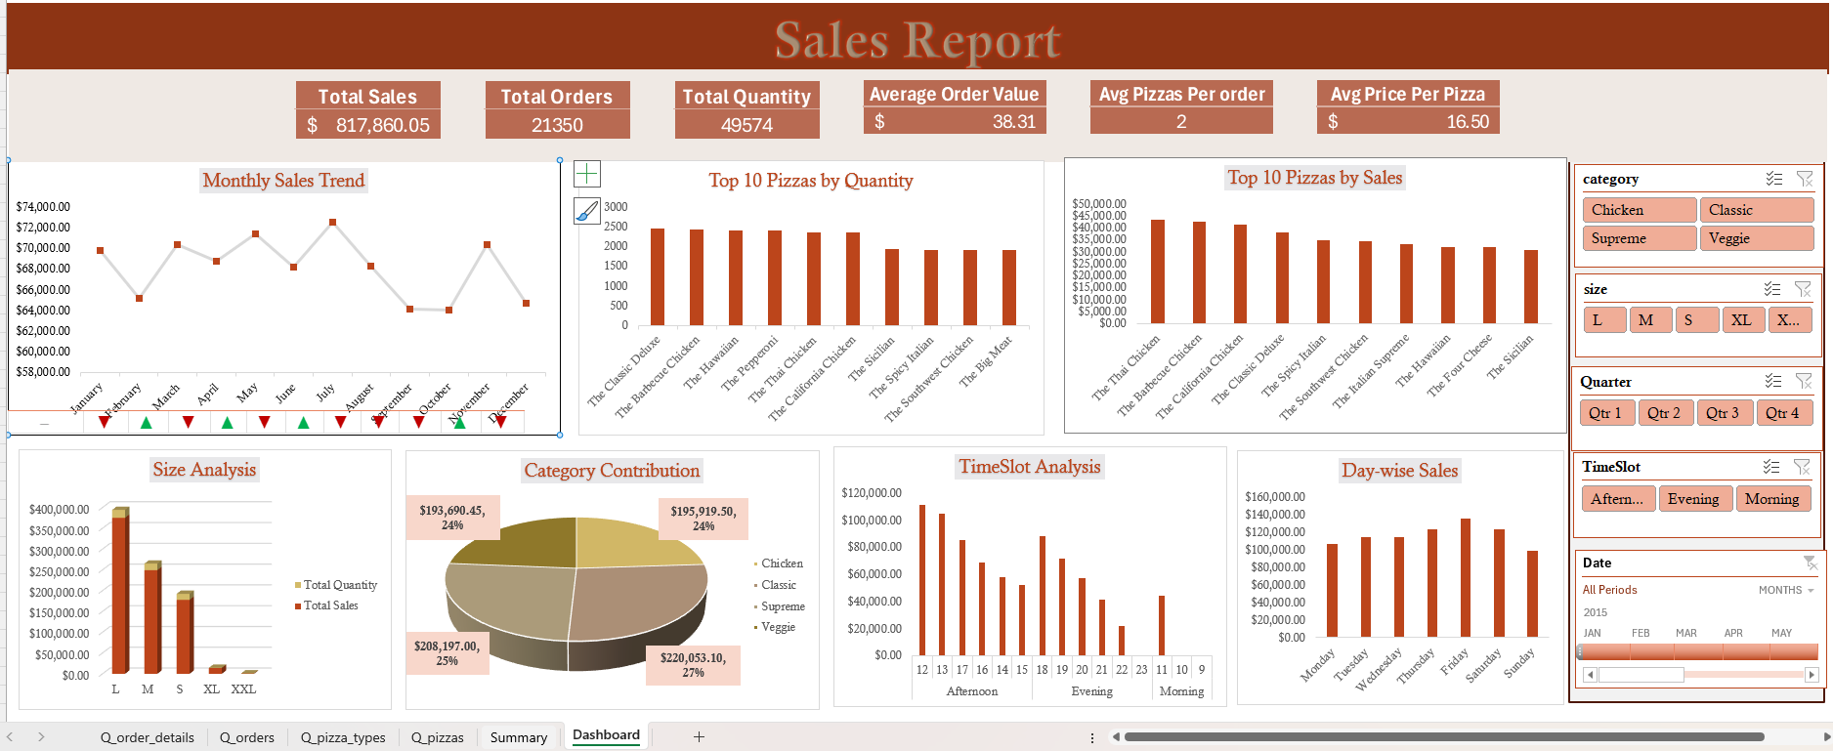
Project Overview
Pizza Sales Analysis Dashboard
Sales performance analysis using Excel
Built with Power Pivot & DAX
Focus on revenue, trends, and customer demand

Slide 3
Problem Statement
The pizza business generates large volumes of sales data across products and time periods. However, the lack of a centralized dashboard makes it difficult to track performance and trends. Key insights on revenue, product contribution, and customer behavior are not easily visible. A clear, interactive Excel dashboard is required to support data-driven decisions.

Slide 4
Objectives
Analyze Overall Sales Performance
Identify Monthly Revenue Trends
Evaluate Product Performance
Understand Customer Ordering Behavior
Enable Data-Driven Decision Making

Slide 5



Data Overview
Dataset: 4 csv files for Pizza Sales Performance (2015)
Tools: Excel, Power Pivot, DAX, Pivot Charts, Power Query
Time Period: Jan 2015 – Dec 2015

Slide 6





Data Preparation
Data Collection: Imported data from 4 csv files(orders, order_details, pizzas, pizza_types)
Data Transformation: Created the ‘Hour’ and ‘Time Slot’ column using Power Query M language for analysis.
Created Calendar Table: Added Columns: Year, Quarter, Month, Day name in Power Pivot
Data Modelling: Establish relationships
1. Order_details -> Orders
2. Order_details -> Pizzas
3. Pizzas-> Pizza_types
4. Orders->Calendar
Prepared for Analysis:
Created Calculated Column: Hour, Time Slot
Measures: Total Sales, Total Quantity, Total Orders, Average Order Value, MOM Growth%, Total Sales%, Average Pizzas per order, Average Price per pizza

Slide 7
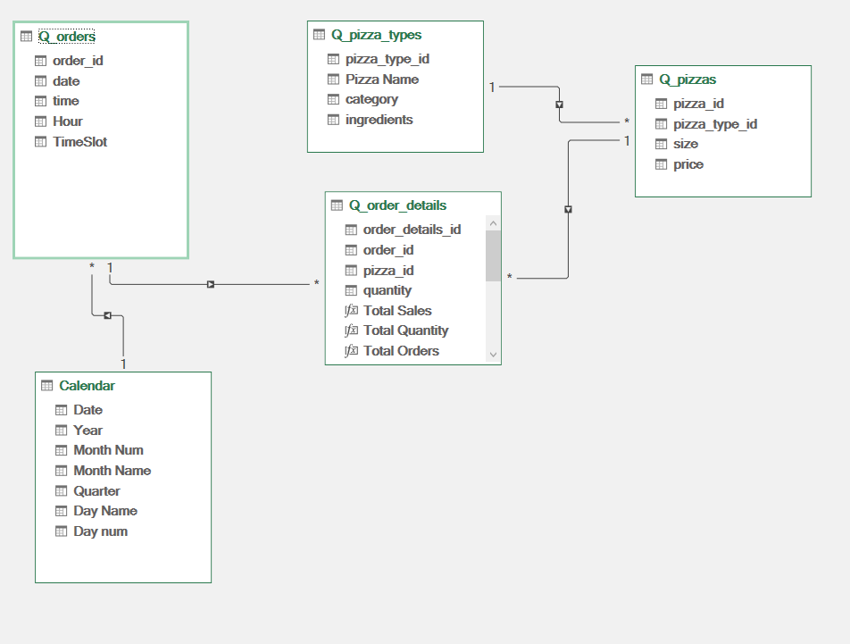
Entity Relationship Diagram

Slide 8
Executive Summary KPIs
Key Performance Indicators
Total Revenue
Total Orders
Average Order Value (AOV)
21,350
Total Orders
$817.9K
Total Revenue
$38.31
Avg Order Value

Slide 9
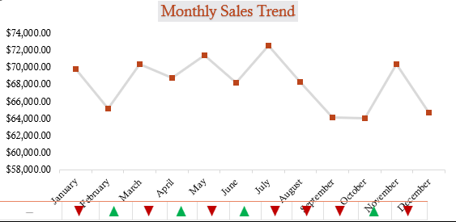
Monthly Revenue Trend
Line chart highlights sales trend over time
KPI arrows indicate MoM growth or decline
Enables quick identification of strong and weak months
▲ Green arrow indicates month-over-month growth
▼ Red arrow indicates month-over-month decline
Monthly Revenue Trend

Slide 10
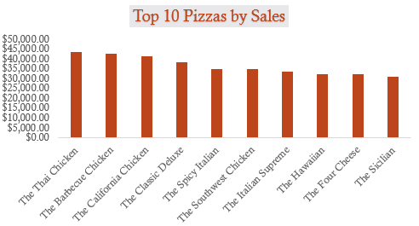
Top 10 Pizzas by Revenue
Top Revenue-Generating Pizzas
Ranked pizzas by total revenue to identify top-performing products
Revenue is concentrated among a few high-performing products
The Thai Chicken and Barbecue Chicken are our financial powerhouses

Slide 11
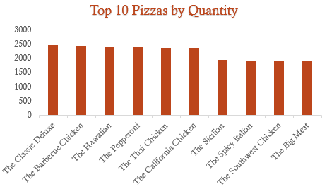
Top 10 Pizzas by Quantity
High-Demand Products
Highlights pizzas with the highest sales volume
Indicates strong customer preference
The Classic Deluxe pizza is the most ordered item, indicating strong and consistent customer preference.

Slide 12
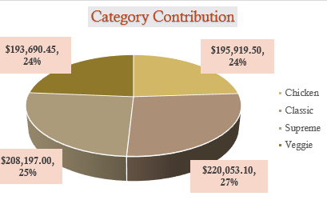
Category-Wise Sales Distribution
Shows revenue split across pizza categories
Classic pizzas lead slightly at $220k, but Supreme, Chicken, and Veggie are all close behind
This balance reduces risk we are not over-reliant on a single flavor profile.
Identifies leading and underperforming categories
Revenue by Category

Slide 13
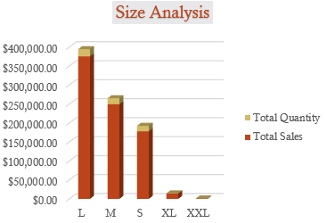
Revenue by Size
Size-Wise Sales Contribution
Compares sales across pizza sizes
Larger sizes contribute more revenue
Indicates strong upsell performance
Large pizzas are the revenue engine, generating $375k nearly double that of Small pizzas.

Slide 14
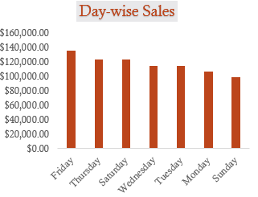
Revenue by Weekday
Weekly Demand Pattern
Compares sales across days of the week
Highlights higher demand on specific days
Supports promotion and resource allocation planning
Friday is the undisputed champion ($136k), followed closely by Thursday and Saturday. These three days anchor our weekly performance.

Slide 15
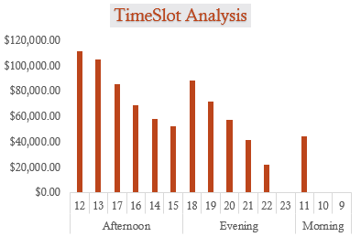
Revenue by Timeslot
Customer Ordering Behavior
Analyzes sales during morning, afternoon, and evening
Identifies peak ordering periods
Peak sales occur during afternoon and evening hours
Useful for staffing and operational planning

Slide 16
Conclusion
Sales performance is driven by a combination of high-volume affordable products and high-revenue premium items.
Clear seasonal and time-based demand patterns exist.
Upselling larger pizza sizes represents a strong revenue growth opportunity.

Slide 17
Recommendations
Promote high-volume, low-revenue pizzas with size or add-on upsell strategies.
Focus marketing efforts on top revenue-generating pizzas.
Align staffing and promotions with peak ordering hours and weekends.
Use seasonal trends to plan targeted monthly campaigns.

Slide 18
Challenges & Learnings
Challenges
Excel limitations in conditional chart formatting.
Auto-generated date table producing incorrect year values (1899).
Learnings & Solutions
Built a custom calendar table using DAX.
Used KPI arrow strips to communicate MoM trends effectively.
Strengthened Power Pivot, DAX, and data modelling skills.

Slide 19

Thank You

